Slide 1

FOTA
FIRMWARE OVER THE AIR

Slide 2
FOTA
SYSTEM DEFINITION
Firmware Over-The-Air, or "FOTA", is a way in which the firmware of a device is updated wirelessly by the manufacturer. Firmware runs in the background and is there to make sure the device's hardware runs properly.

Slide 3
TABLE OF CONTENTS
01
02
03
04
Introduction
Problem Statement
Objective & Goals
System Overview

Slide 4
TABLE OF CONTENTS
06
07
FOTA System
Bootloader
05
System Flow and Hardware Design
Automotive Cybersecurity Techniques
08
Mobile Application

Slide 5
TABLE OF CONTENTS
09
FOTA
Server
10
Testing and Validation

Slide 6
— Nikola Tesla
“When wireless is perfectly applied the whole earth will be converted into a huge brain.”

Slide 7
01
INTRODUCTION

Slide 8


INTRODUCTION
In today's world, most devices have at least 100 million lines of code. So, when a company wants to add a new feature to a device, it's not practical to do it manually. Instead, they use automated methods.
Since the 1960s, cars have gone from being mostly mechanical to incorporating a lot of software, making them what we now call “SDV (Software Defined Vehicles)." This shift represents a big change in how cars work.

Slide 9
02
PROBLEM STATEMENT

Slide 10


PROBLEM STATEMENT
In today's technology-driven world, Smart Cars are equipped
with complex coding that requires regular updates to enhance
features and fix bugs. The manual updating of each car at the
Original Equipment Manufacturer (OEM) level would be a
highly impractical task.
Impleme­nting this approach could potentially lead to customer dissatisfaction, especially in cases where crucial bugs need urgent attention but cannot be promptly resolved. He­nce, there is an urge­nt requirement for an automate­d system that can streamline the­ process of updating and fixing bugs efficiently.

Slide 11
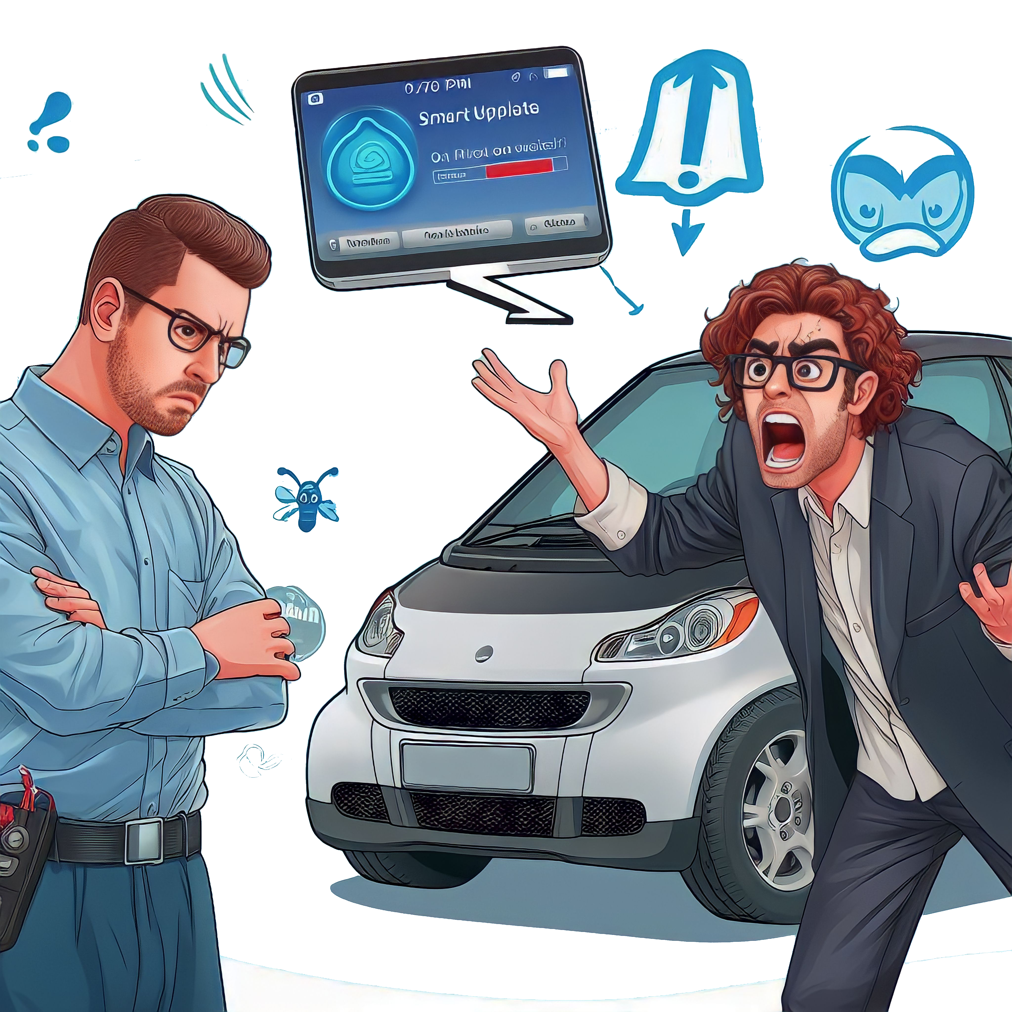
A PICTURE IS WORTH A THOUSAND WORDS

Slide 12

Ford Recalls More Than 430,000 Vehicles Due to Software Defects
- The Guardian

Slide 13
OBJECTIVES & GOALS
03

Slide 14




OBJECTIVES & GOALS
Bug Fixing
Time-Saving
Cost-Effective
More Secure

Slide 15
SYSTEM OVERVIEW
04

Slide 16

SYSTEM OVERVIEW
01
02
03
ORIGINAL EQUIPMENT MANUFACTURER (OEM)
Uploading
SERVER
VEHICLE
Update
WIFI Channel

Slide 17
FOTA SYSTEM
05
System Flow and Hardware Design

Slide 18
FOTA OVERVIEW
FOTA refers to the technology that allows manufacturers to wirelessly update the firmware of electronic control units (ECUs) in vehicles. This capability enables the delivery of new features, bug fixes, and performance improvements without requiring physical access to the vehicle.
With increased connectivity, vehicles are more vulnerable to cyberattacks. Ensuring the security of automotive systems is critical to protect against unauthorized access, data breaches, and potential physical harm.

Slide 19

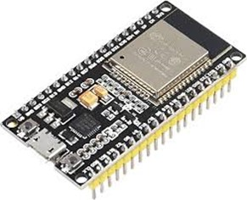

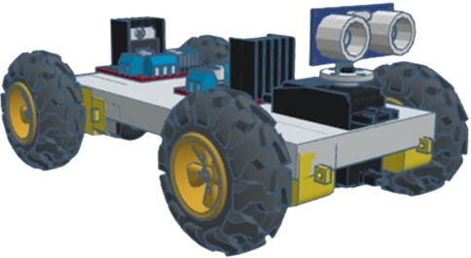
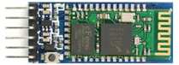
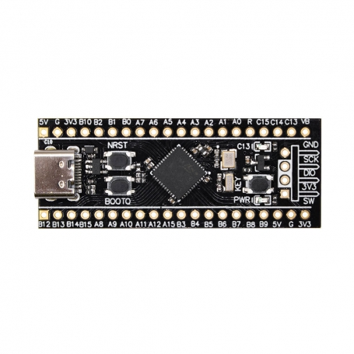

HARDWARE DESIGN
Application
User Interface
Gateway
NodeMCU ESP32
OEM Server
Requests
Obstacles Avoidance
Car
Bluetooth Module
HC-05
Electronic Control Unit
STM32F401RCT6 (Black Pill)

Slide 20
Dual-function ECU
The STM32F401RCT6 is utilized as a Two-View Electronic Control Unit (ECU), functioning both as the Main ECU and the Application ECU.
Main ECU: flashing of code and the OTA updates via the bootloader.
Application ECU: integrating peripherals with the hardware components to work with the Obstacles Avoidance Vehicle.
Electronic Control Unit
STM32F401RCT6 (Black Pill)
Linker script file is essential in configuring the STM32F401RCT6 (Black Pill) to operate as a dual-function Electronic Control Unit (ECU).

Slide 21
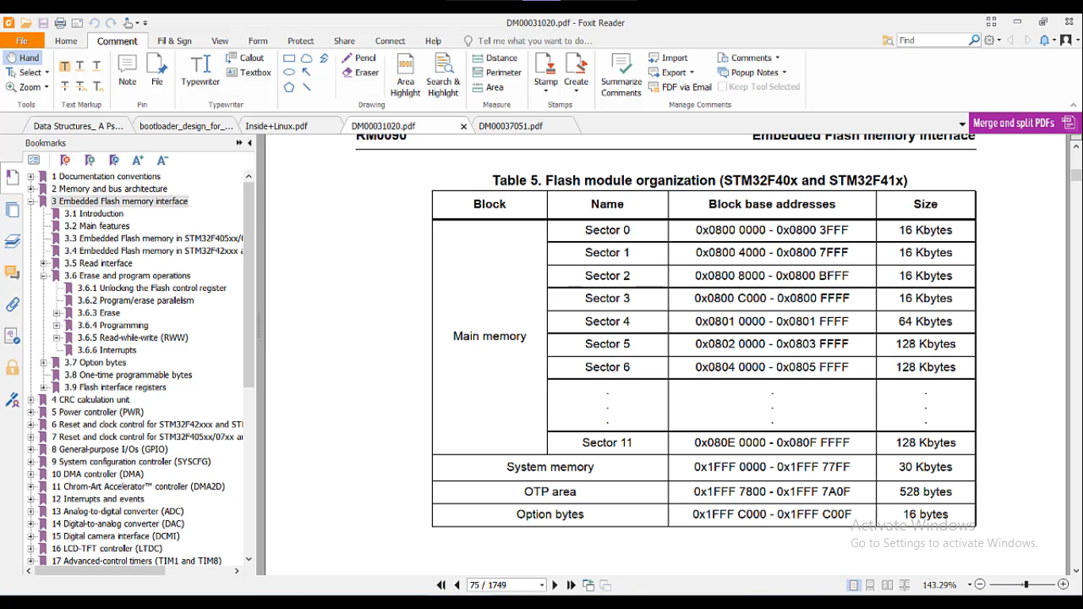
Memory Architecture
Main Memory Consists of
12 Sectors.
The Bootloader Starts From
Sector 0 to Sector 2.
The Application Starts From
Sector 2 at address 0x8008000.

Slide 22

Application ECU
The Application is responsible for managing the car's behavior, focusing on obstacle detection and avoidance.
It interfaces with DC motors, ultrasonic sensor to navigate the car safely and a buzzer to alert obstacle detection.
This entire process operates in a feedback loop, continuously detecting obstacles, measuring distances, and adjusting motor controls to dynamically navigate the vehicle around obstacles and avoid it efficiently.

Slide 23
















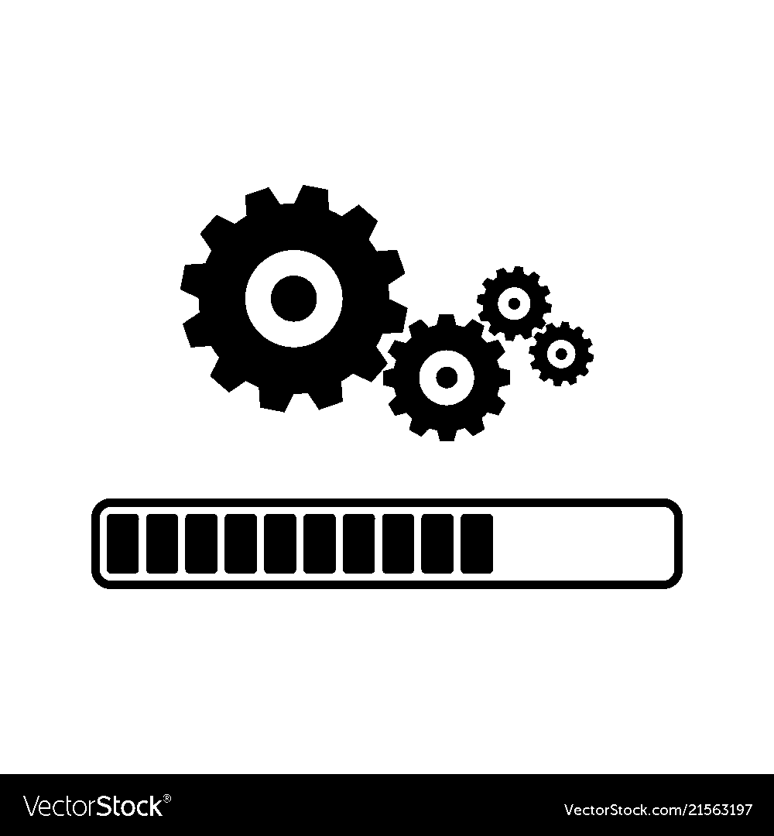
SYSTEM FLOW
Vehicle Owner
OEM
Reports problem
Releases new firmware update
Critical update
Additional feature
User Interface
Update Begins
Accepted
Refused
Request
Update
Snoozed
Wireless Media
Response
Target Memory Sector
Flashing Firmware
Firmware update
Bootloader
Gateway
OEM Server

Slide 24
Bootloader
06

Slide 25
Bootloader
Bootloader is a small program that resides in the non-volatile memory of a microcontroller. Its primary function is to initialize the system and load the main application program (firmware) into the system’s flash memory for execution.
The bootloader’s most critical function is to load the main application firmware into memory.

Slide 26
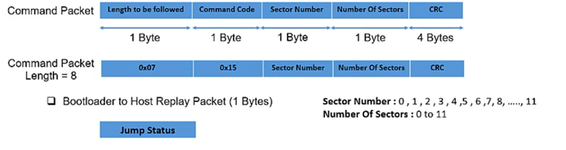
Bootloader Commands Handling
Sector Erase of the User flash
Slide By: Eng. Ahmed Abd El-Ghafar

Slide 27
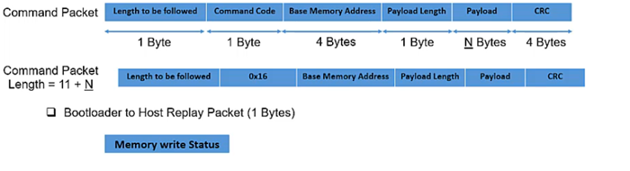
Bootloader Commands Handling
Write data into different memories of the MCU
Slide By: Eng. Ahmed Abd El-Ghafar

Slide 28
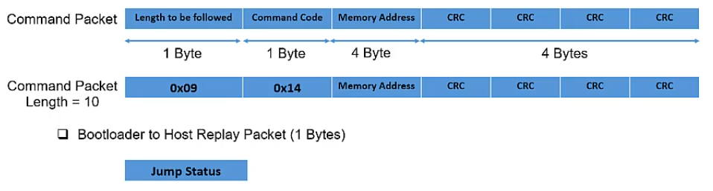
Bootloader Commands Handling
Jump Bootloader to specified address
Slide By: Eng. Ahmed Abd El-Ghafar

Slide 29
Automotive Cybersecurity Techniques
07

Slide 30
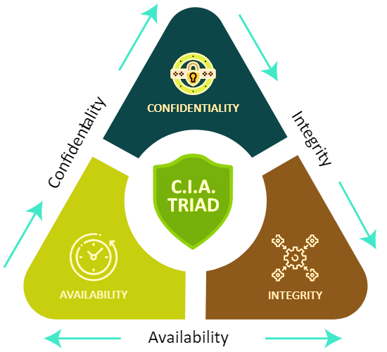
Automotive Cybersecurity Techniques

Slide 31

Automotive Cybersecurity Techniques
In today's digital age, data security is crucial. With increased reliance on online platforms, the risks of breaches and cyberattacks rise. Ensuring data confidentiality, integrity, and availability is essential for compliance and trust.
Firstly, we have implemented a robust encryption algorithm. This ensures that all data transmitted within our network is rendered unreadable to unauthorized parties, effectively protecting it from interception and eavesdropping attempts by malicious actors. Encryption serves as the first line of defence.
In addition to encryption, we have also conducted extensive penetration testing on our servers. Penetration testing involves simulating cyberattacks on our systems to identify and address potential vulnerabilities before they can be exploited by real attackers.

Slide 32
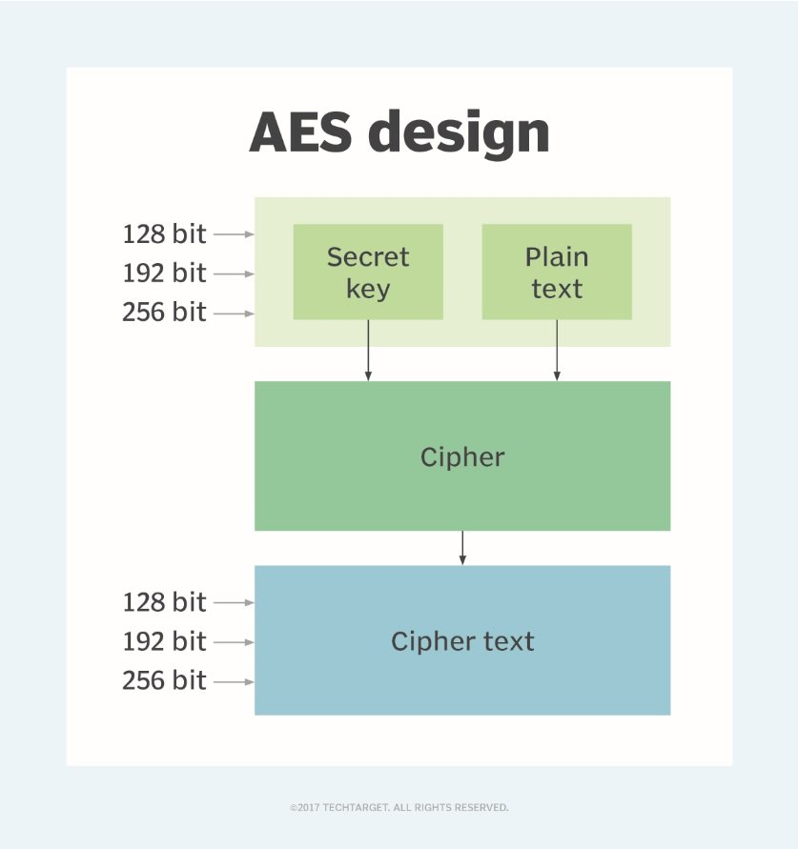
Encryption
We use the AES encryption algorithm to secure our data. AES, or Advanced Encryption Standard, is a highly secure and widely trusted method for protecting information from unauthorized access.
We used AES-128 encryption algorithm

Slide 33





Securing Server
Admin
Members
Login (2FA)
OEM Server
Client
Upload Firmware

Slide 34
Mobile Application
08

Slide 35
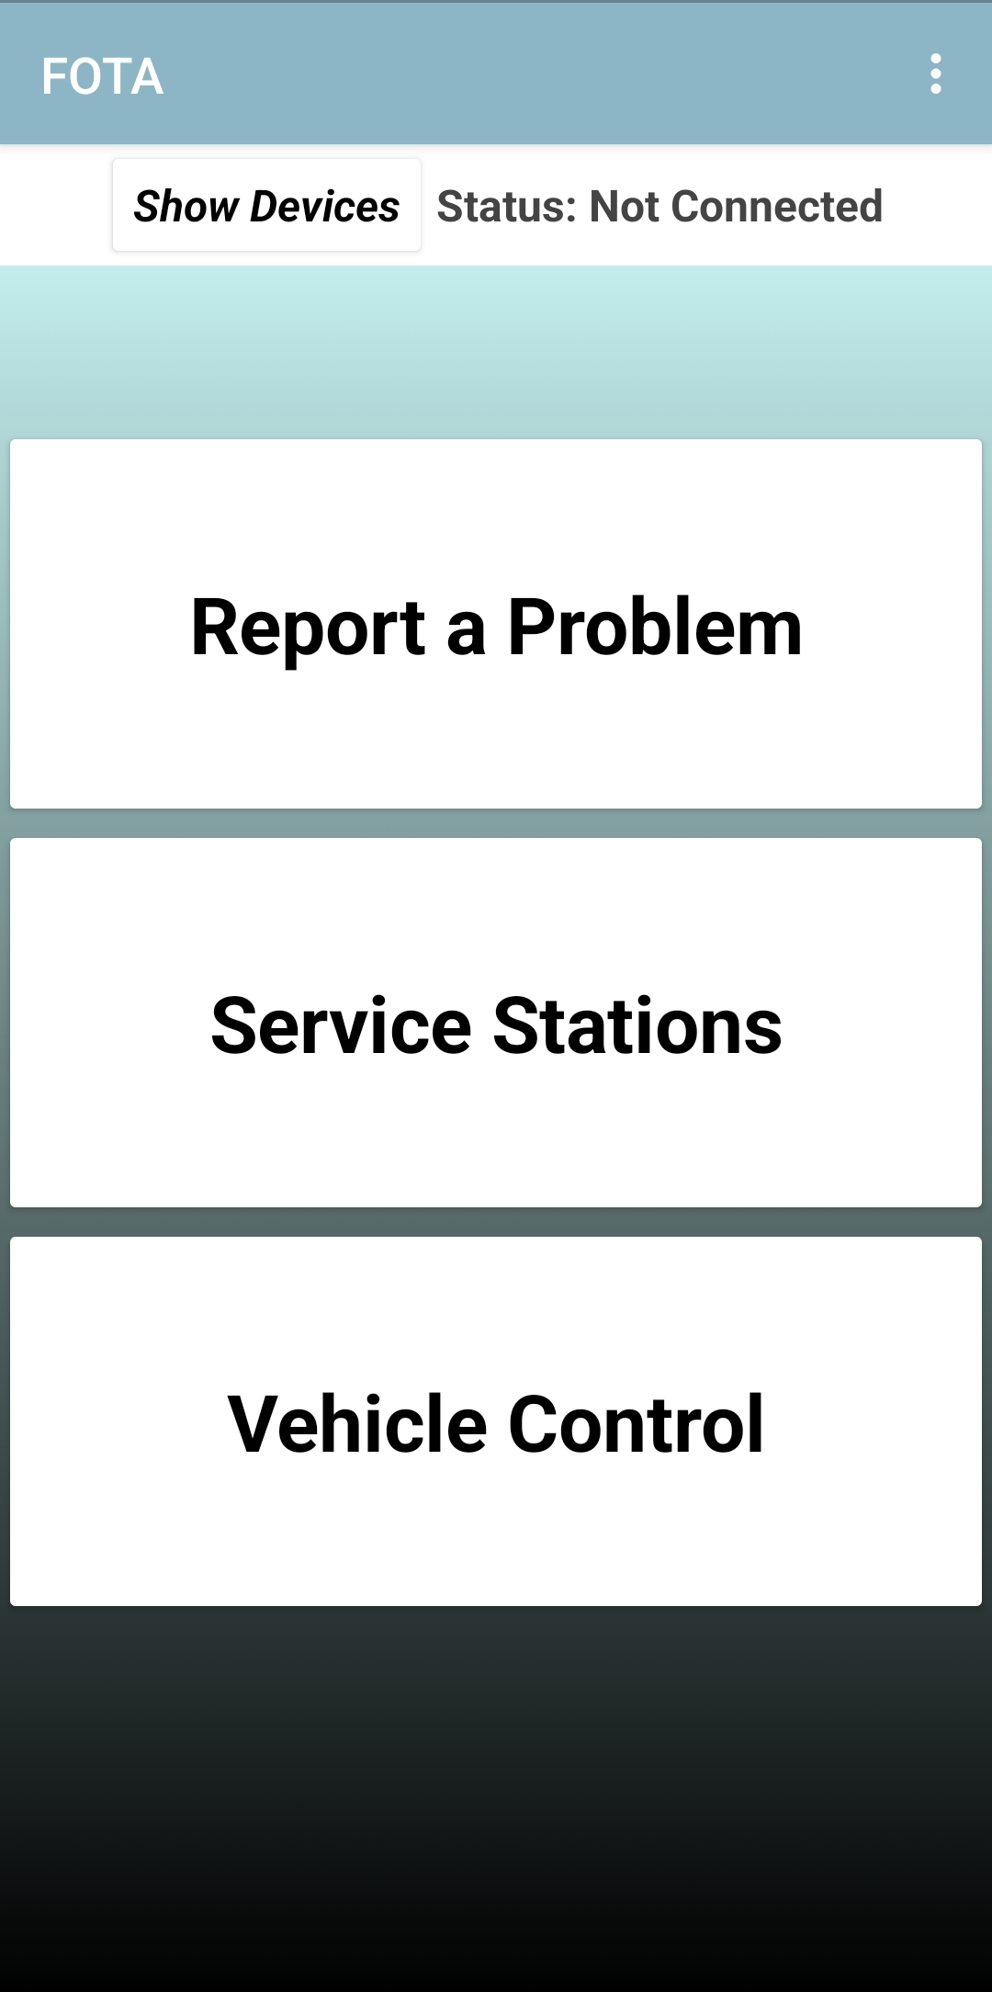
Mobile Application
The Mobile Application is designed to run on the dashboard within the vehicle, simplifying the user's interaction with the system and providing a responsive dashboard for the vehicle.
User interacts with simple UI and choose from different buttons on the Mobile Application.

Slide 36
Wireless Connection
Purpose:
Functionalities:
Establishes a connection between the app and vehicle via the HC-05 Bluetooth module.
Establishes a connection between the app and Server via the Wi-Fi Connection.
Enables the app to send and receive data wirelessly.
Facilitates functionalities like vehicle control, Report a Problem and Notifications.

Slide 37
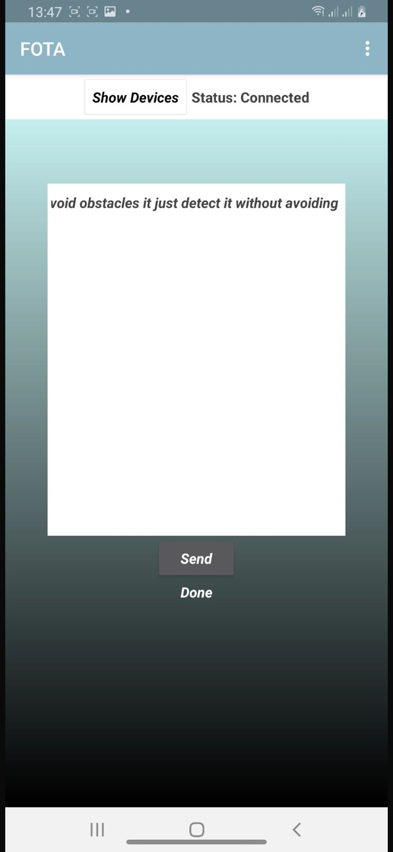
Functionalities: Report A Problem
This is an essential feature that allows the user to report any issues they are having with the system to the server.
The technical team will then attempt to resolve the issue and notify the user of any updates.

Slide 38
Functionalities: Service Stations
If the user encounters any problems in the car that cannot be solved using Software Updates, he can use this option to search for the nearby service stations to him and go to them directly.
This functionality depended on the device's built-in location services through Google Maps APIs.
Benefits of shifting from a GPS hardware module to a software solution:
Greater compatibility across different devices.
Reduced hardware costs.
Simplified maintenance.
Allows for more frequent updates and improvements.

Slide 39
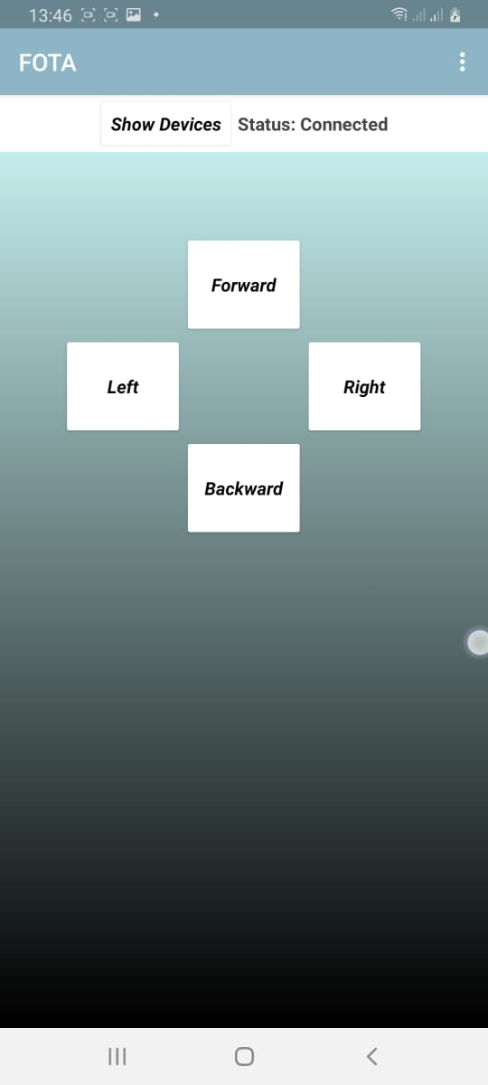
Functionalities: Vehicle Control
Purpose: Controls vehicle movement in four directions: forward, backward, left, and right.
Operation:
Users press buttons to send movement commands to the vehicle.
In real life we don’t need this functionality as it’s used only to test the vehicle movements.
Commands are executed remotely using the Bluetooth module.

Slide 40
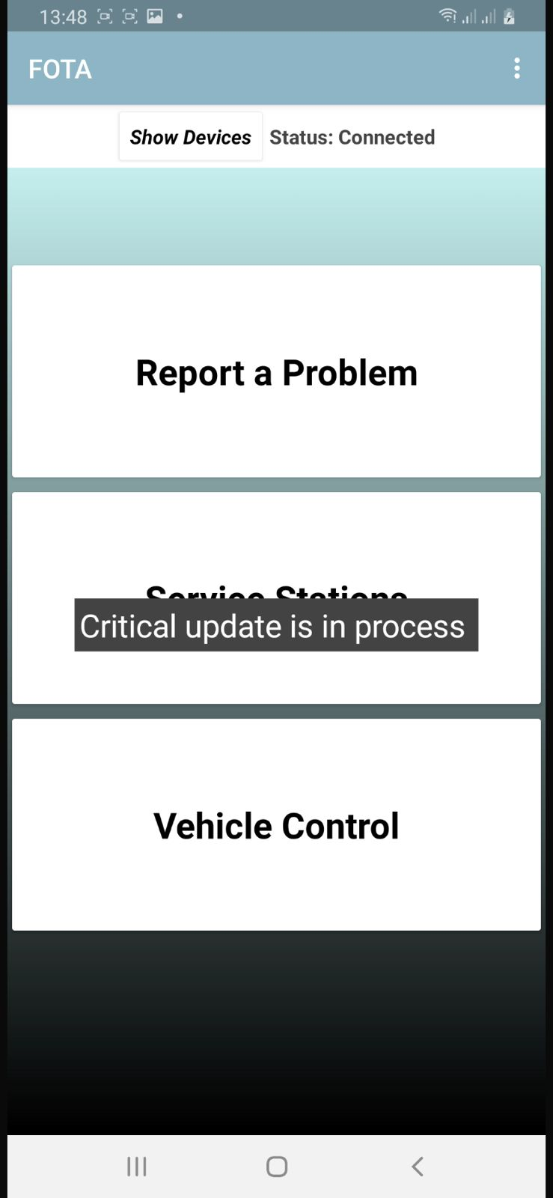
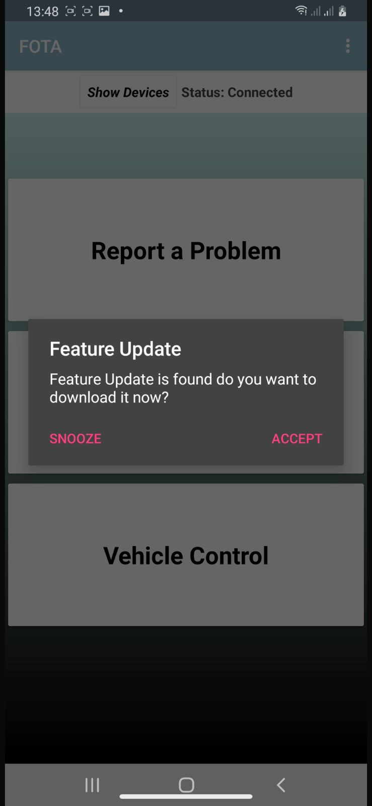
Notification and Alerts
Notifications and alerts are one of the most important means of communication between the user and the server, as the application always listens to the server and waits until there is an update.
There are two types of notifications:
Critical update notifications: when the update is mandatory and no choice to snooze it.
Additional Feature Update notifications: when the update is optional, and the user can accept or snooze it.

Slide 41
FOTA SERVER
09

Slide 42
Organization and Privileges
Organization:
Admins: System Managers, Extensive Capabilities.
Users: Task-Specific Operators, Limited Access.
Privileges:
Admins: Add/Delete Users , Change Roles, Update Credentials, Manage Files and Tickets.
Users: Upload/Download Files, Send Updates to Clients, Receive Tickets.

Slide 43
Server Workflow: User
Login Process:
Standard Login: Users enter credentials → Enter OTP.
First-Time Login: Users enter credentials → QR code pops up → Scan QR code with Google Authenticator → Enter OTP.
Forgot QR Code: Users can request a new QR code from admins.
File Management:
Upload Files: Users can upload files to the server.
Update Types:
Critical Update: Push updates to clients.
Feature Addition: Pull updates.

Slide 44
Server Workflow: User
Client Ticket Management:
View and Handle Tickets:
Users can view tickets from clients.
Handle client tickets during subsequent updates.

Slide 45
Server Workflow: Admin
Login Process:
Standard Login: Admins enter credentials → Enter OTP.
Support Actions:
Resend QR Code: Admins can resend QR codes to users if forgotten.
Admin QR Code: Admins can retrieve their QR code if forgotten.

Slide 46
Access Control
Personal Dashboard:
Individualized dashboard for each user
File Visibility: Only user-uploaded files are visible.
Ticket Visibility: All client tickets are visible to users.
File Access Control:
Tracking: Includes upload time, uploader’s identity, and file name.
Audit Trail: Facilitates issue tracking.
Activity Logs: Logs for each admin's recent actions.
Admin Panel Actions: Includes admin panel activities.
Admin Access Control

Slide 47
Security Features
Two-Factor Authentication (2FA):
TOTP (Time-based One Time Password) for enhanced user authentication.
Data Encryption:
AES encryption for database file storage.
Password Security:
Passwords hashed in the database using sha256(pbkdf2) algorithm.
Penetration Testing:
Regular tests to identify and fix vulnerabilities, including prevention of injection attacks, secure handling of file upload, and access broken control.

Slide 48
Testing and Validation
10

Slide 49
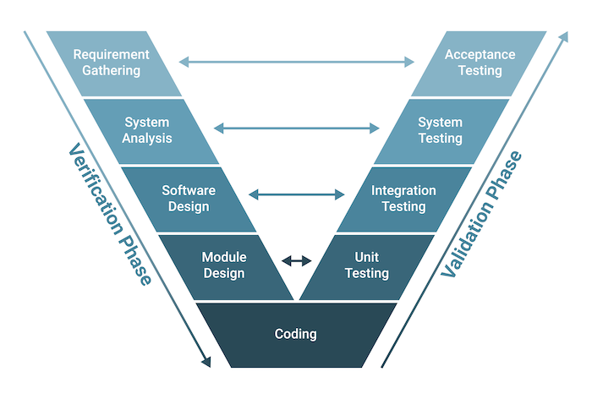
V MODEL

Slide 50
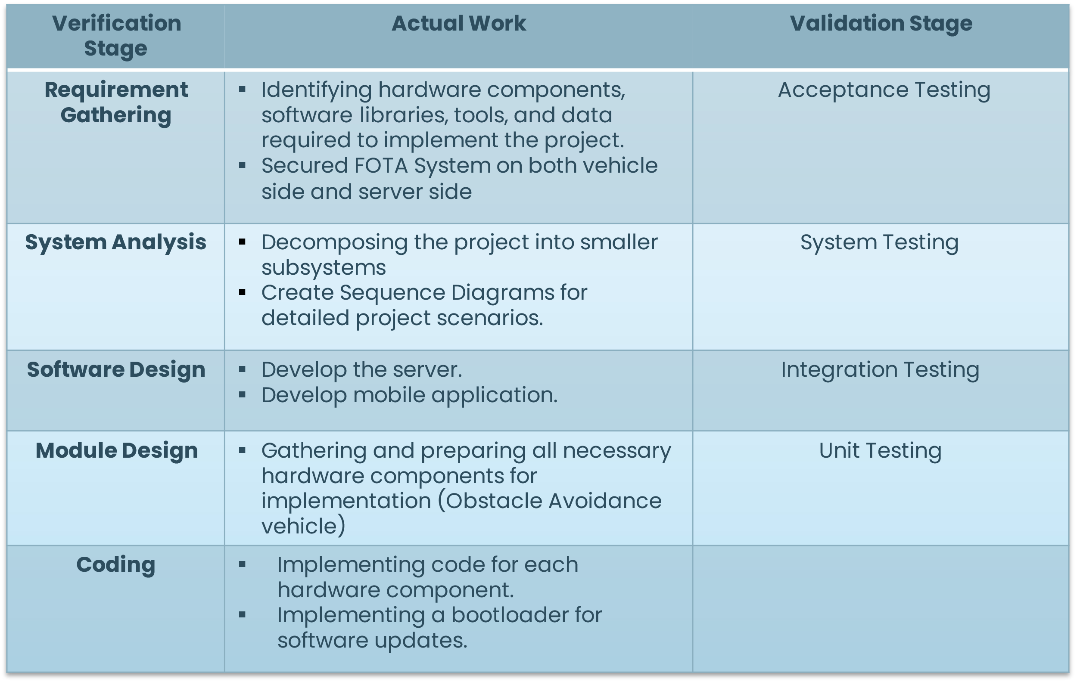
V MODEL STAGES

Slide 51
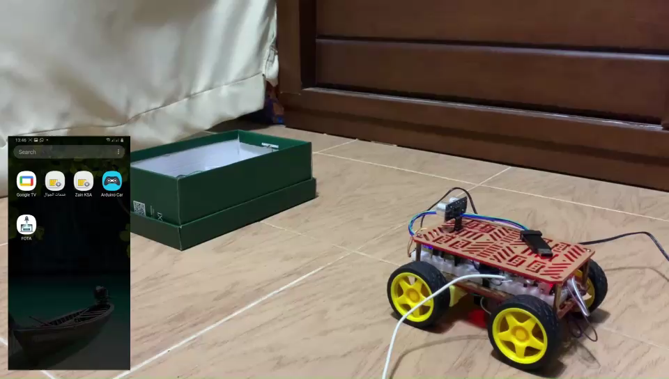
SYSTEM FLOW

Slide 52
THANKS!

